Slide 1
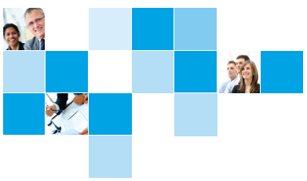
Outlook for the Federal Highway Trust Fund
NATIONAL COUNCIL OF COUNTY ASSOCIATION EXECUTIVES
PRESIDENTS & EXECUTIVE DIRECTORS MEETING
WASHINGTON, DC
JANUARY 9, 2014
Janet Oakley
Director of Policy and Government Relations
American Association of State Highway and Transportation Officials (AASHTO)

Slide 2
Surface transportation has long relied on user fees.
“It'll be paid for by those of us who use the system, and it will cost the average car owner only about $30 a year. That's less than the cost of a couple of shock absorbers. Most important of all, it'll cost far less to act now than it would to delay until further damage is done.”
President Reagan, November 23, 1982
“And the proposal was, as we called it, a "users fee" to differentiate [that] this is not a tax for general revenues.”
President Reagan, January 5, 1983
Source: Federal Highway Administration, “Palace Coup: President Ronald Reagan and the Surface Transportation Assistance Act of 1982”

Slide 3
HTF Headwinds: #1. Americans aren’t driving as much.
Source: Federal Highway Administration

Slide 4
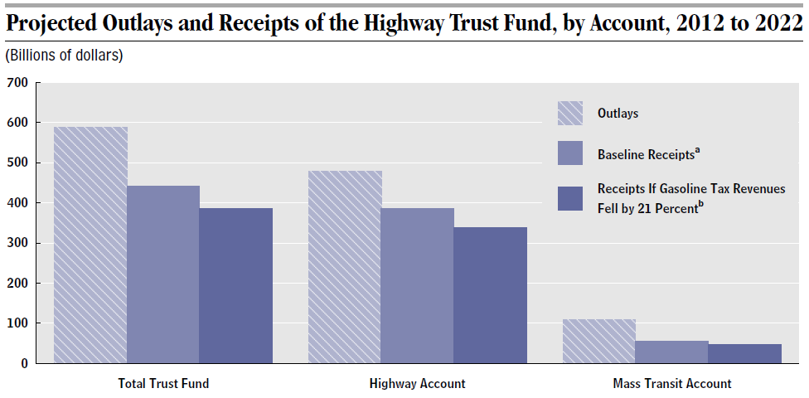
HTF Headwinds: #3. Alternative fuel vehicles will further erode future HTF receipts.
$57B drop
Source: Congressional Budget Office

Slide 5
HTF Headwinds: #2. Gas tax has lost its purchasing power.

Slide 6
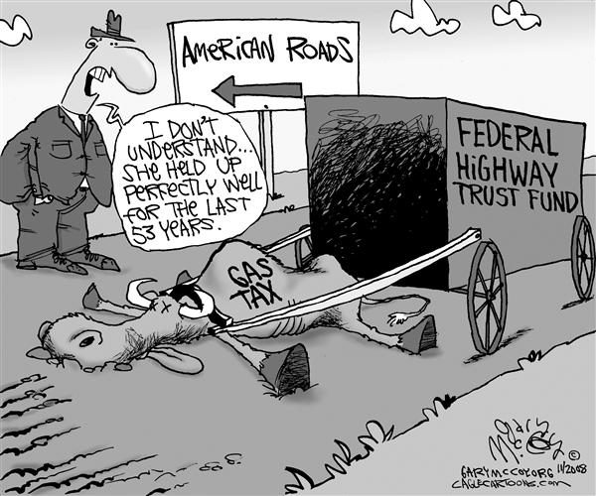
Like prior bills, MAP-21 relies on the Highway Trust Fund—the backbone of Federal surface transportation funding since 1956.
Motor fuel taxes have typically comprised 89% of Highway Trust Fund revenues. But they face an uncertain long-term future.
Source: Gary McCoy, CagleCartoons.com; Congressional Budget Office.

Slide 7
General Fund transfers have avoided the HTF “fiscal cliff.”
FY 2008: $8 billion General Fund transfer to HTF
FY 2009: $7 billion General Fund transfer to HTF
FY 2010: $19.5 billion General Fund transfer to the Highway Trust Fund
FY 2012: $2.4 billion Leaking Underground Storage Tank Trust Fund transfer to HTF*
FY 2013: $5.9 billion General Fund transfer to HTF**
FY 2014: $11.7 billion General Fund transfer to HTF**
Total General Fund transfers to Highway Trust Fund: $52.1 billion since 2008
* This is not a transfer from General Fund as a portion of HTF receipts are normally deposited into Leaking Underground Storage Tank Trust Fund.
** Amount transferred after budgetary sequester.

Slide 8
Outlays outpace receipts: About $15 billion per year and more for a foreseeable future.
Notes:
This visual shows the structural imbalance we currently have for the Highway Trust Fund. Between 2008 and 2014, it is expected to receive about $55 billion dollars in transfers from the General Fund and a storage tank fund.
Clearly, this is not a sustainable scenario going forward, where from 2015 to 2023, the average gap between the money coming into the Trust Fund and the money leaving the Trust Fund is expected to be about $15 billion every single year.
As the Highway Trust Fund is not allowed to incur negative balance unlike the general fund, there are three courses of possible actions after MAP-21 expires in 2014.
Put more General Fund dollars into the Highway Trust Fund
Enact higher user fees to sufficiently cover the outlays
Significantly cut back on obligations and therefore outlays in future years
The first two options are politically challenging to say the least, and the third option is simply unacceptable.

Slide 9
The cliff: Federal highway obligations fall nearly 100% in FY 2015 without new revenue.

Slide 10
Technically feasible revenue options

Slide 11
Illustratively, shoring up HTF would not present an unreasonable burden.
Average household pays $46 in federal and state gas tax per month. This is less than per monthly cost of:
Electricity and gas: $160
Cell phone: $161
Cable and internet access: $124
For example, a 10-cent increase in the federal gas tax translates to $1.15 more for the average driver per week—an action that would fix the Highway Trust Fund shortfall
Source: American Road and Transportation Builders Association

Slide 12
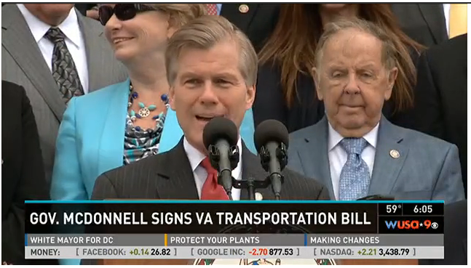
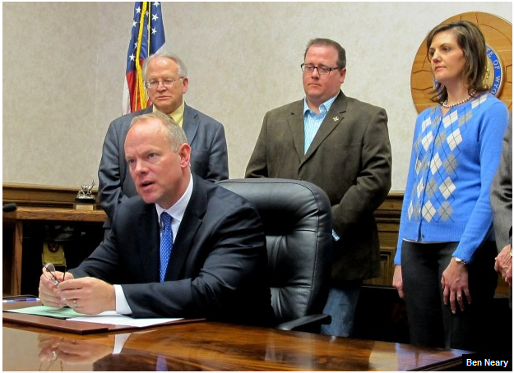
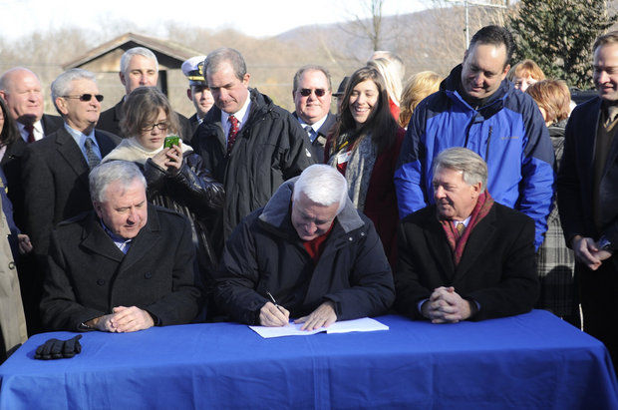
State and Local Governments are Addressing the Transportation Revenue Challenge
Governor Mead signs Wyoming fuel tax increase into law
Governor Corbett signs $2.3 billion Pennsylvania transportation bill

Slide 13
2013 State Transportation Revenue Measures
In 2013 State of the State Messages 32 of 50 Governors focused on the need for transportation infrastructure investment
Raising fuel taxes: California, Maryland, Massachusetts, Vermont, Wyoming
Directing gas tax proceeds or oil and gas revenues to transportation uses: Texas
Reducing gas tax, but increasing other taxes for a net increase for transportation: Pennsylvania, Virginia
State sales tax toward transportation: Arkansas, Virginia
Sales taxes on fuel, or other variable taxes/fees: District of Columbia, Maryland, Massachusetts, Pennsylvania, Virginia, Vermont
Vehicle registration fees: Pennsylvania, Virginia,

Slide 14
2013 State Transportation Revenue Measures
Vehicle Miles Traveled (VMT) Fee: Oregon
Framework to study a VMT fee: Washington
Special fees or taxes for electric or alternative fuel vehicles: Virginia, Washington, Indiana, North Carolina, West Virginia
2013 State and Local Transportation Funding Ballot Measures – 25 0f 29 measures approved [86%] with a total value of $716 million
Source: National Conference of State Legislatures.

Slide 15
Some common themes behind state success stories
Needs are reasonable and relatable to the public
Potential benefits of investment are clear
Political leadership from the executive branch
Broad coalition of supporters beyond self-interested groups

Slide 16
Looking Ahead Key Near Term Milestones
Early 2014: Continued implementation of MAP-21; Reauthorization discussions to continue, including potential development of legislation
January 15: Current Continuing Resolution expires
Early February 2014: President’s budget proposal for FY 2015
February 7: Debt ceiling suspension is lifted
April 2014: FY 2015 budget resolution is developed
Sep 30, 2014: Expiration of MAP-21
Oct 1, 2014: New authorization or extension of MAP-21
Summer 2014 to Spring 2015: Highway Trust Fund shortfall reached if no new revenues found

